Slide 1
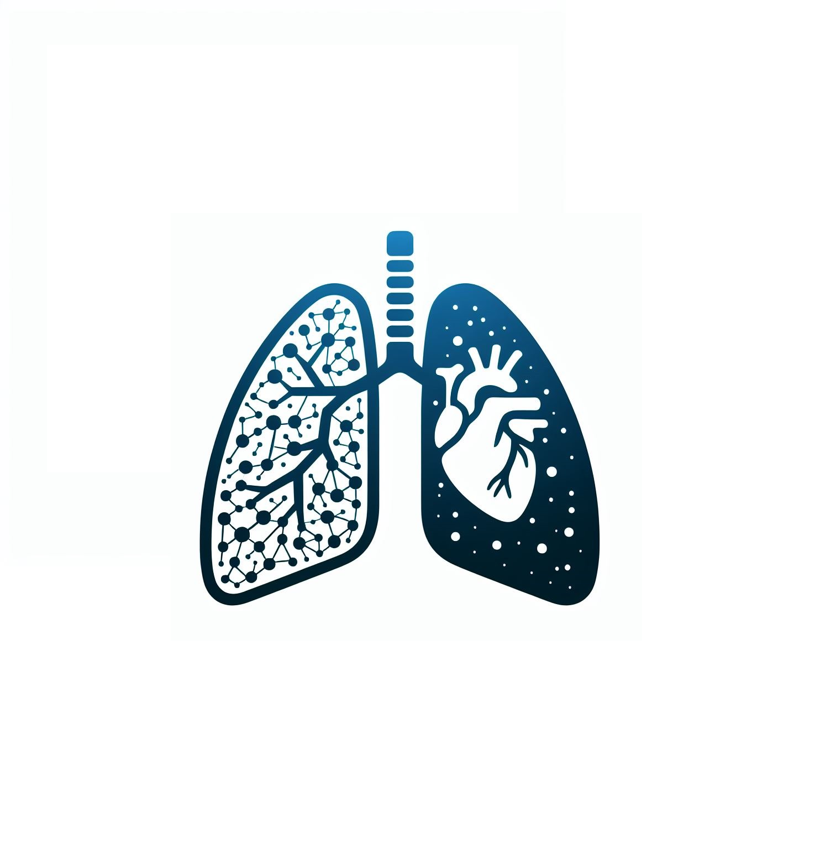
CardioResp AI
R24-019

Slide 2

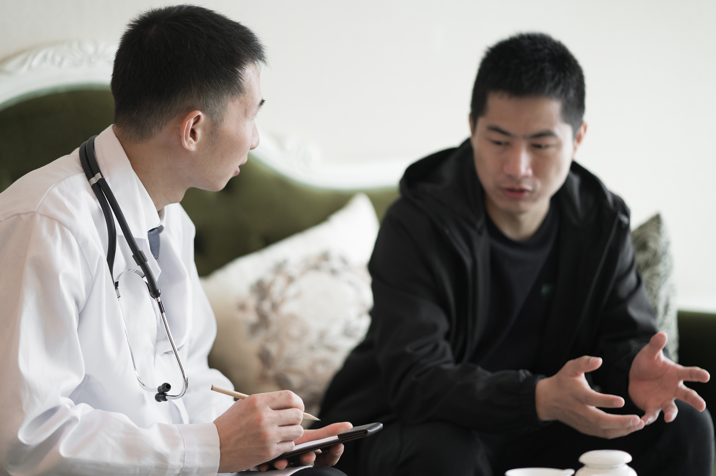
Introduction
Cardiovascular diseases [1] and COPD [13] are the leading and third leading causes of death globally, respectively.
High costs and long wait times hinder access to essential diagnostic tests, especially for individuals with limited financial means [14].
Traditional diagnostic tools like X-rays are expensive and carry risks, such as the potential for developing cancer [15].
Our research aims to develop affordable, accessible, and safe self-assessment solutions for identifying pulmonary and cardiac issues.

Slide 3

Research Problem
Over 17.9 million people die due to cardiovascular diseases annually
Over 3 million people die due to Chronic Obstructive respiratory Disease
Millions of people are struggling at hospitals fighting for their lives due to heart and respiratory diseases
Even in an era where technology is at its pinnacle, Millions of human lives are still at risk

Slide 4

Research Objectives
Objectives
Generate a 3D model of the lung using 2D images & Scan chest area from camera and generate an X ray simulation of the chest
Using Convolutional Neural Network identify Respiratory abnormalities of X ray generated and generate a 3D model based on a real time video feed
Identification of Cardiac Rhythm through the Analysis of Palms
Identification of Cardiac Rhythm through Facial Analysis
Remote Health Monitoring
A Revolutionary Software for Autonomous Detection of Pulmonary and Cardiac Abnormalities

Slide 5
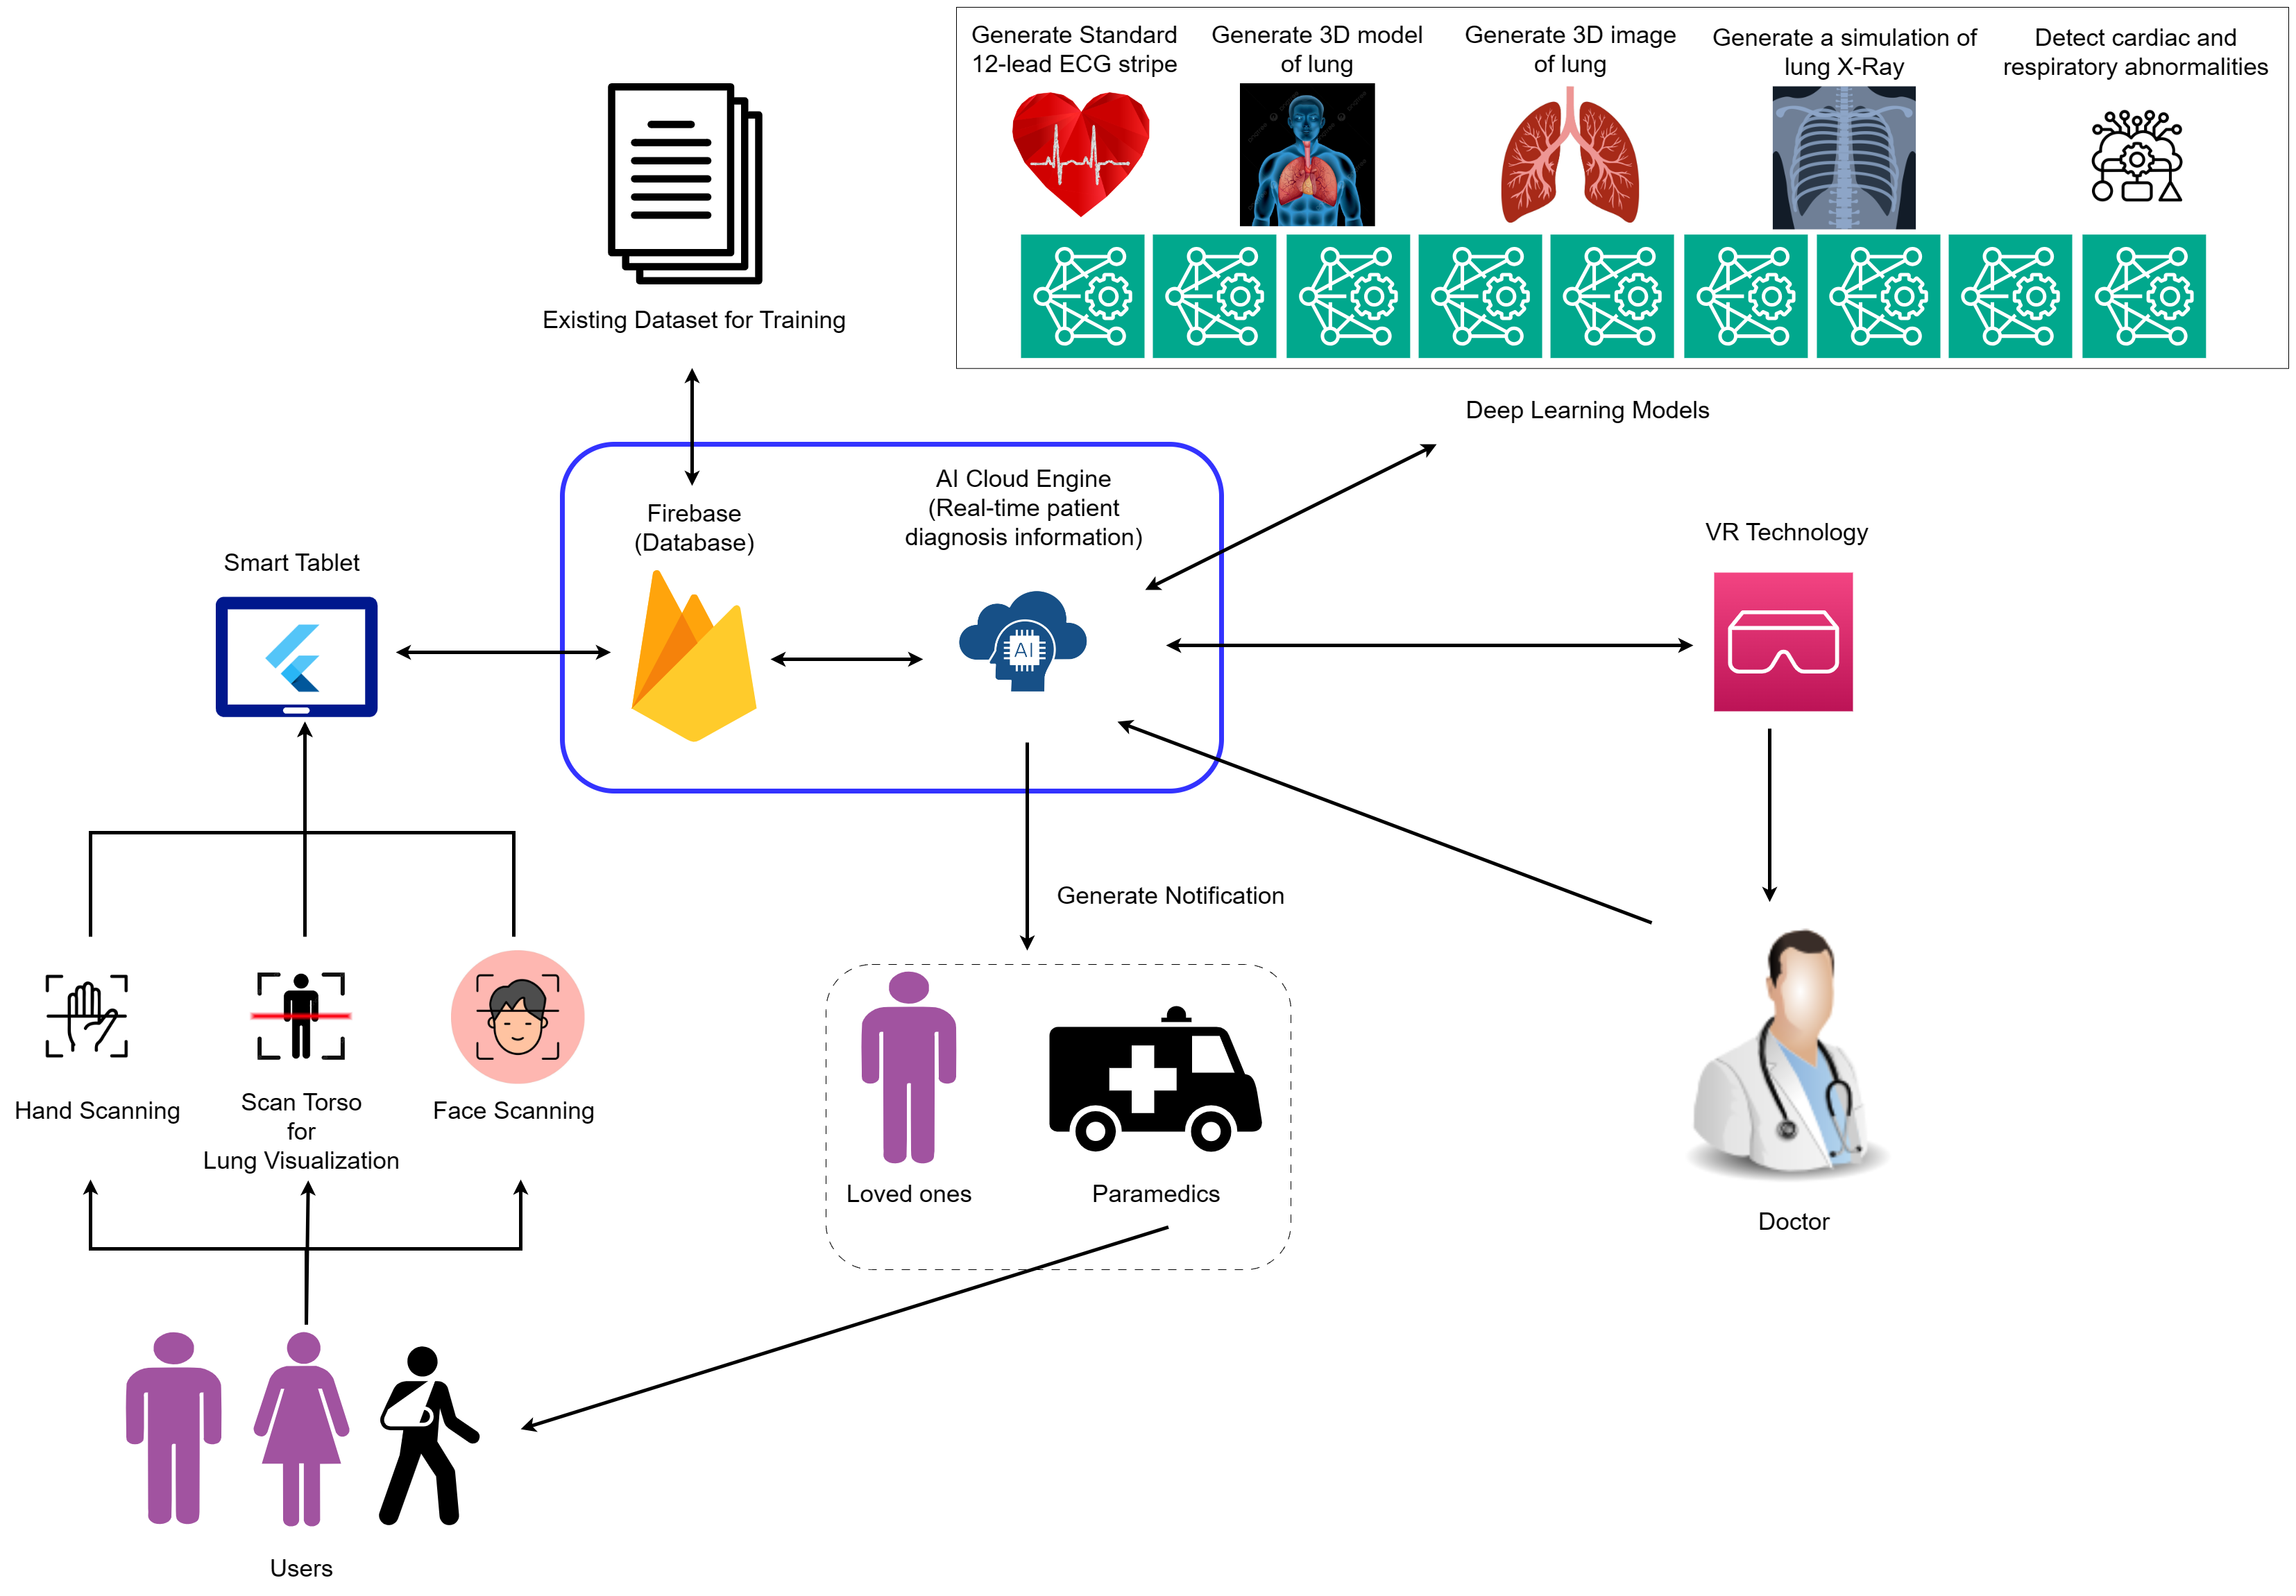
System Diagram

Slide 6
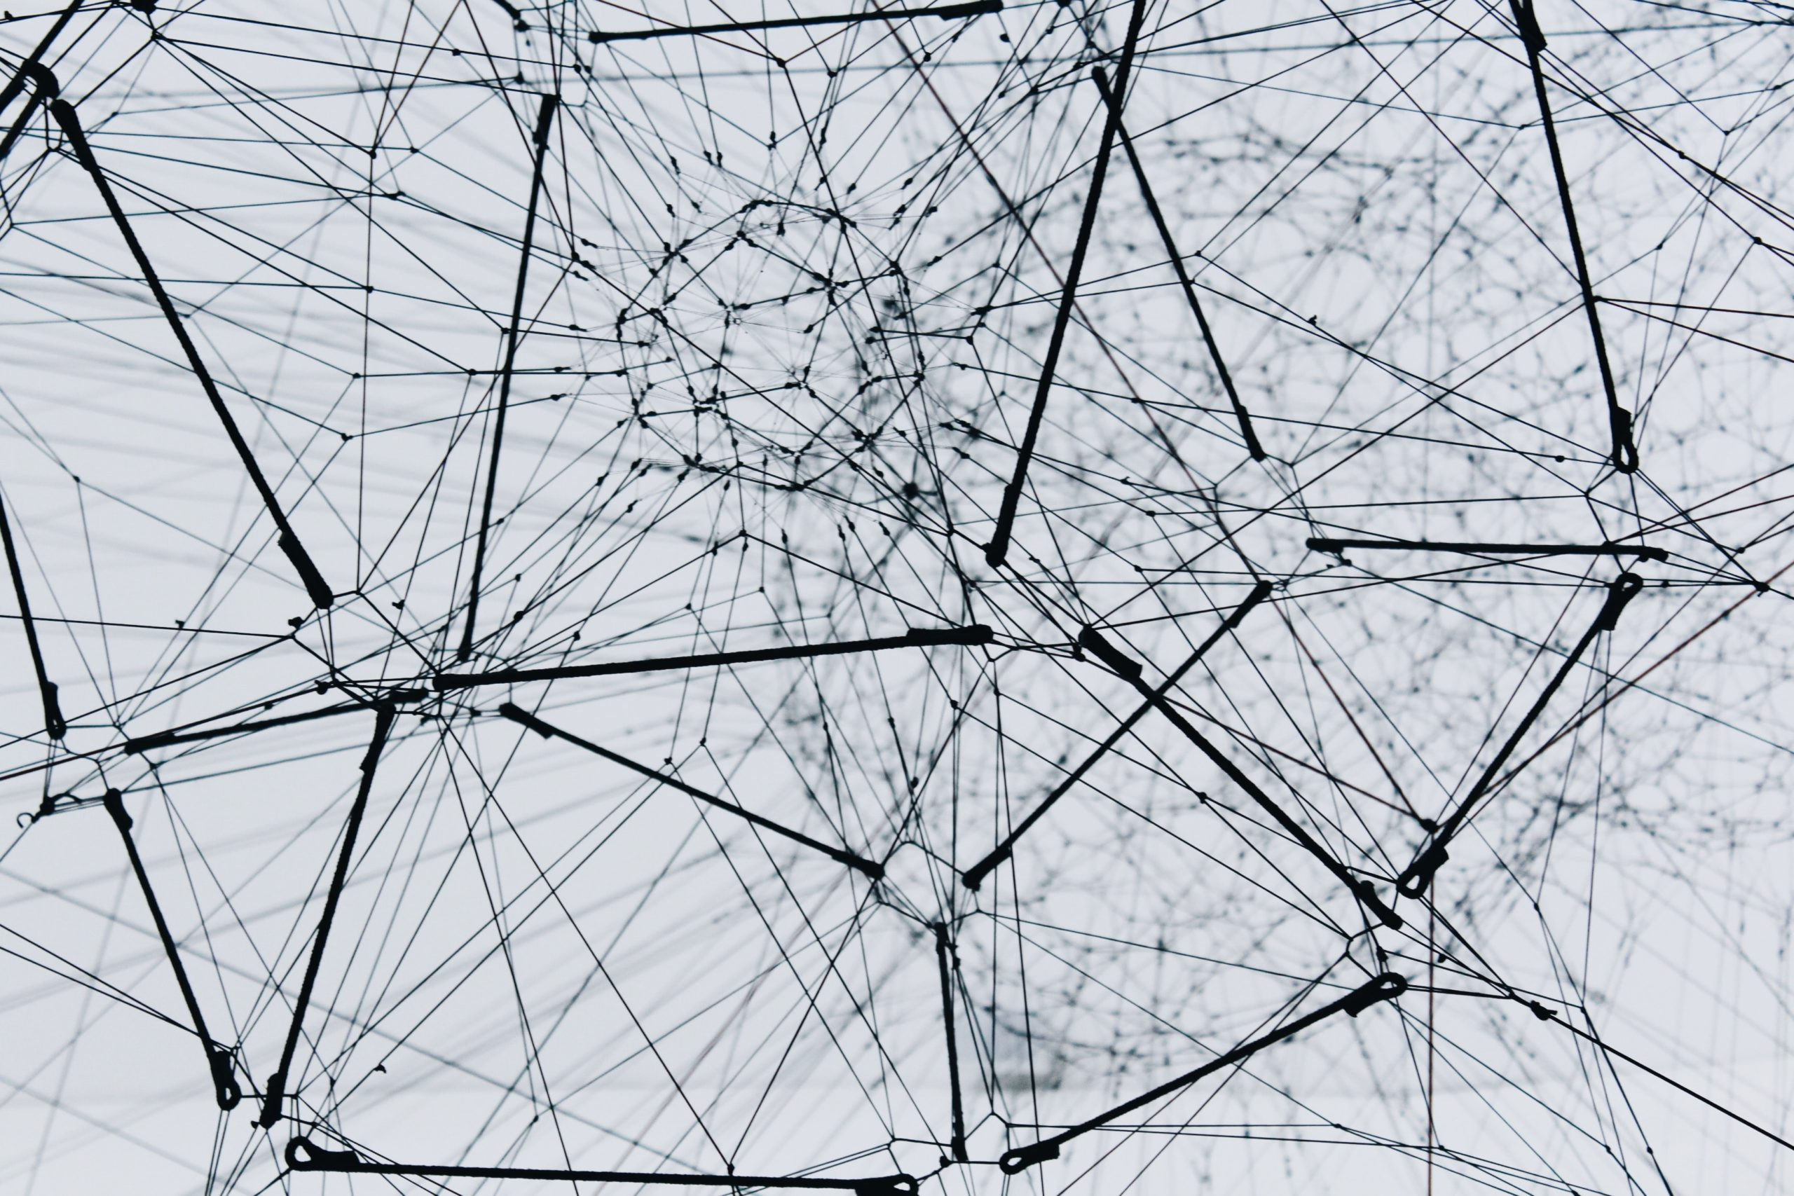

IT21134180 | Vihansa S.A.S
Specialization : Software Engineering
IT21134180 | Vihansa S.A.S | R24-019

Slide 7
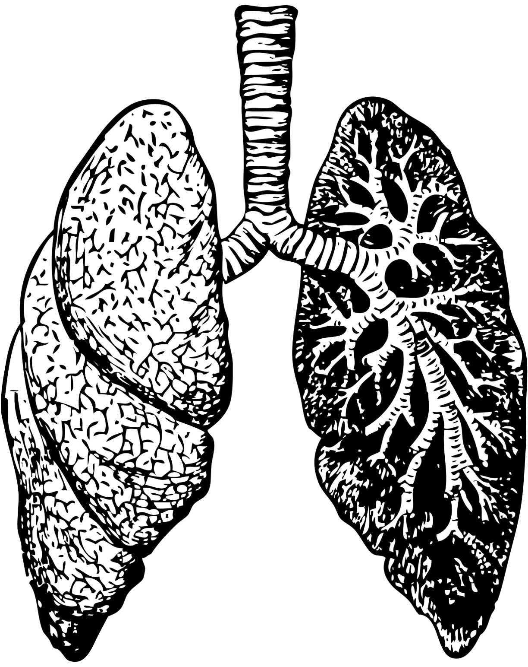

Introduction
Anatomical visualization is crucial for physicians, aiding in assessing lung condition, detecting heart issues, and evaluating blood vessel positioning via chest X-rays.
2D chest X-rays sometimes lack detail, prompting the need for advanced imaging like CT scans for accurate diagnosis.
Accessibility issues to advanced imaging in developing countries like Sri Lanka pose challenges, potentially worsening patient conditions due to lengthy waiting lists.
Radiologists interpret X-ray readings, but there's a shortage of these specialized professionals, highlighting the potential of AI for precise diagnosis.
IT21134180 | Vihansa S.A.S | R24-019

Slide 8
Research Problem
How to generate a 3D model from a 360 degree video of a person?
How to identify the defects in simulated X-Ray image generated and produce an accurate prediction?
IT21134180 | Vihansa S.A.S | R24-019

Slide 9
Objectives
Generate 3D model of lung based on 360 degree video of a person
Generating a 3D model out of the simulated x ray and predict the lung abnormalities visualized by the X ray simulation
Embed the features obtained by the X Ray Simulation to the 3D model
Classifying lung abnormalities to a model by feeding datasets of lung abnormalities
Predicting the result of as the generated X Ray simulation is a healthy X Ray or an X Ray with a defect.
IT21134180 | Vihansa S.A.S | R24-019

Slide 10
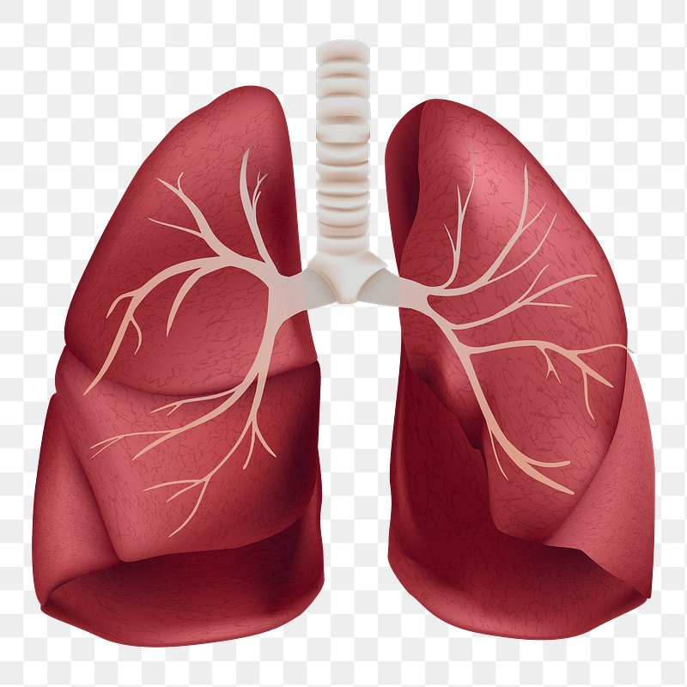
Methodology
Functional Requirements
Generate a lung 3D model out of a 360 degree video of a person.
Embed the features displayed in the X ray simulation to the 3D model.
Train model to predict lung abnormalities
Ensure high accuracy is gained
User friendly User Interfaces to interact with.
IT21134180 | Vihansa S.A.S | R24-019

Slide 11
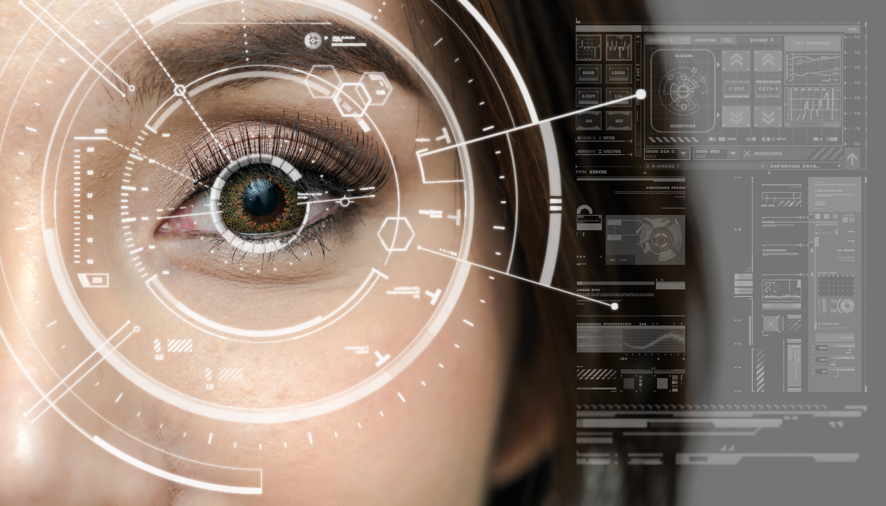
Methodology Cont.
Flutter
Python
Kaggle Notebook
Firebase
TensorFlow
Jupyter Notebook
self calibration model
Voting Algorithm
Structure from Motion (SFM)
K-means clustering
VGG16 (CNN Network)
MeshRoom
Technique
Thresholding
Technology
Algorithm
Framework
IT21134180 | Vihansa S.A.S | R24-019

Slide 12
Methodology
IT21134180 | Vihansa S.A.S | R24-019

Slide 13
Work Breakdown Structure
Initiation
Project charter submission
Create a project proposal
Planning
Requirement analysis
Feasibility study
Design
Create use-case diagram
Create ER diagram
Implementation
Closeout
Gathering the relevant datasets
Create sequence diagram
Build a dataset matching to the diagnosed abnormalities
Publish research paper
Final presentation
Host the mobile application
Design wireframes for mobile application
Design Mobile interfaces
Predict diet plan with physiological data such as heart rate, spo2, blood glucose level, cholestrol and ECG
Generate diet progress report
Predict diet plan based on demographic data such as age, gender, weight and height
IT21134180 | Vihansa S.A.S | R24-019

Slide 14
References
[1]D. Kvak et al., “Chest X-ray Abnormality Detection by Using Artificial Intelligence: A Single-Site Retrospective Study of Deep Learning Model Performance,” BioMedInformatics, Jan. 13, 2023. [Online]. Available: https://doi.org/10.3390/biomedinformatics3010006
[2]Z. Mustafa and H. Nsour, “Using Computer Vision Techniques to Automatically Detect Abnormalities in Chest X-rays,” Diagnostics, Sep. 18, 2023. [Online]. Available: https://doi.org/10.3390/diagnostics13182979
[3] A. Fitzgibbon and A. Zisserman, "Automatic 3D model acquisition and generation of new images from video sequences," 9th European Signal Processing Conference (EUSIPCO 1998), Rhodes, Greece, 1998, pp. 1-8. keywords: {Three-dimensional displays;Cameras;Tensile stress;Geometry;Robustness;Feature extraction;Estimation},
[4] “GENERATING 3D MODEL FROM VIDEO - UKLO Repository.” [Online]. Available: https://eprints.uklo.edu.mk/id/eprint/5082
IT21134180 | Vihansa S.A.S | R24-019

Slide 15
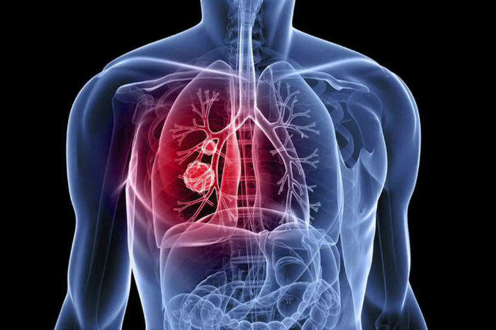
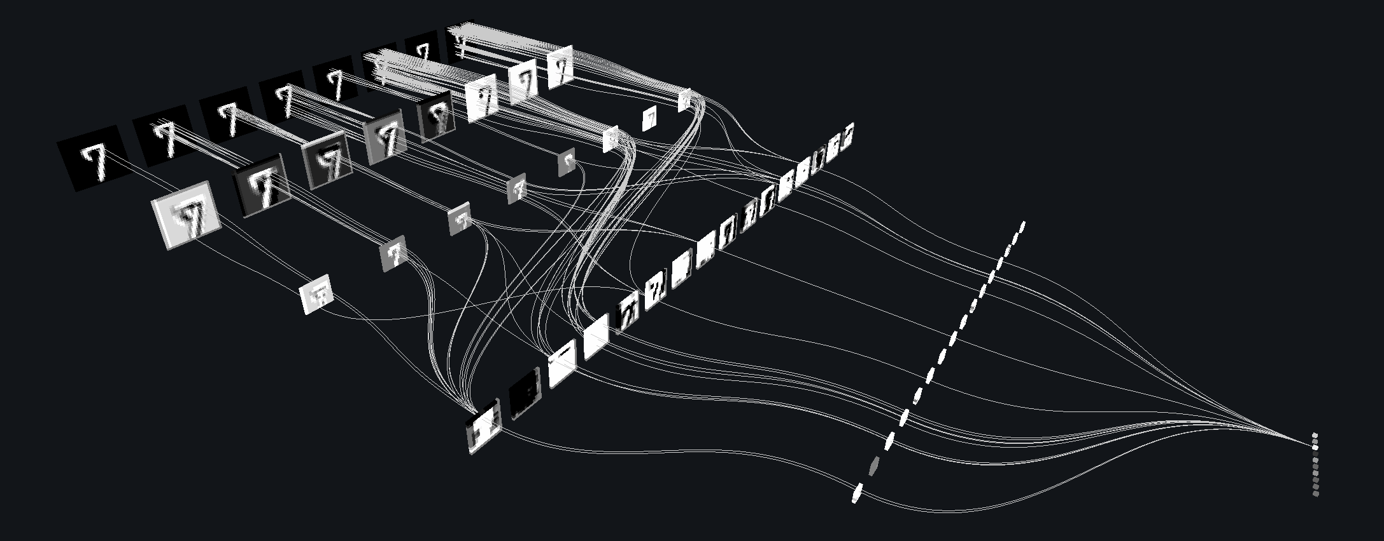
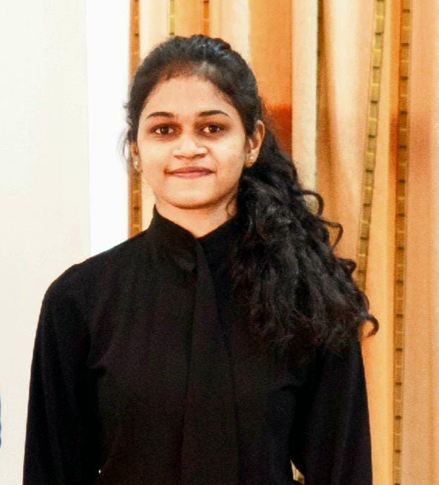
IT21127946 | Christy H.M
Specialization : Software Engineering
IT21127946 | Christy H.M | R24-019

Slide 16

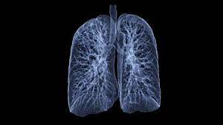
Introduction
The highest number of deaths among infectious diseases is reported for TB patients in Sri Lanka which is around 500 – 600 annually.
Nearly 90% of COPD (Chronic Obstructive Pulmonary Disease) deaths in those under 70 years of age occur in low- and middle-income countries (LMIC).
A study reveals that misdiagnosis Seriously Harms 795,000 People Annually.
IT21127946 | Christy H.M | R24-019

Slide 17

Research Problem
How to eliminate the inconvenience of hospital visits, and swiftly capture and produce chest X-rays?
How to improve the accuracy of clinical decision making and provide enhanced diagnosis of lung related diseases.
IT21127946 | Christy H.M | R24-019

Slide 18

Objectives
Image identification of the chest area.
Segmentation of layers of the image, and extraction the details of the bones.
Generation of a simulated chest x-ray image.
Convert the simulated x-ray image to greyscale.
Removal of unnecessary noise using K-means clustering algorithms.
Thresholding mechanisms are applied along with High Dynamic ranging, to sharpen images.
3D Reconstruction of the 2D X-ray image is generated.
Generation of simulated chest X-ray images via a camera connected to a tablet and generate a 3D simulation of an X-ray image.
IT21127946 | Christy H.M | R24-019

Slide 19
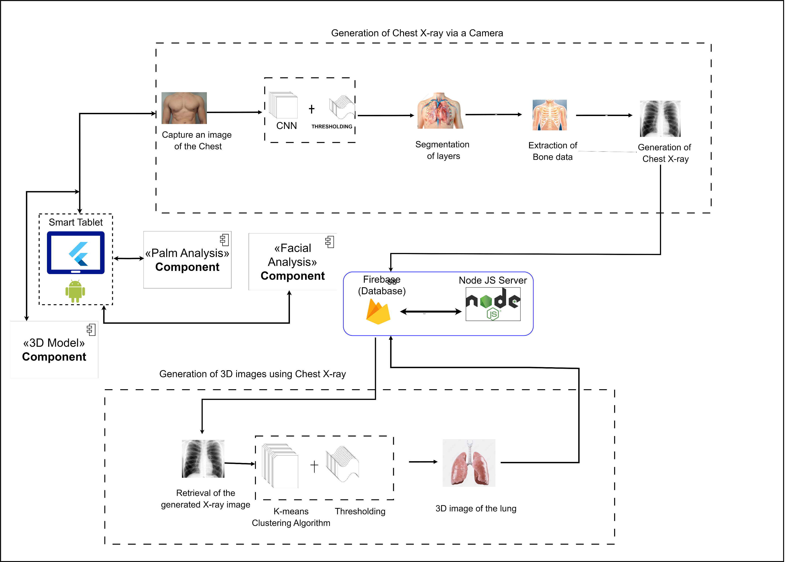
Methodology
IT21127946 | Christy H.M | R24-019

Slide 20
Methodology
Functional Requirements
Visualize a simulated chest x-ray image via a tablet device.
Generation of a 3D image from the simulated 2D simulated x-ray image.
Higher accuracy of results
High degree of reliability.
User friendly User Interfaces to interact with.
IT21127946 | Christy H.M | R24-019

Slide 21
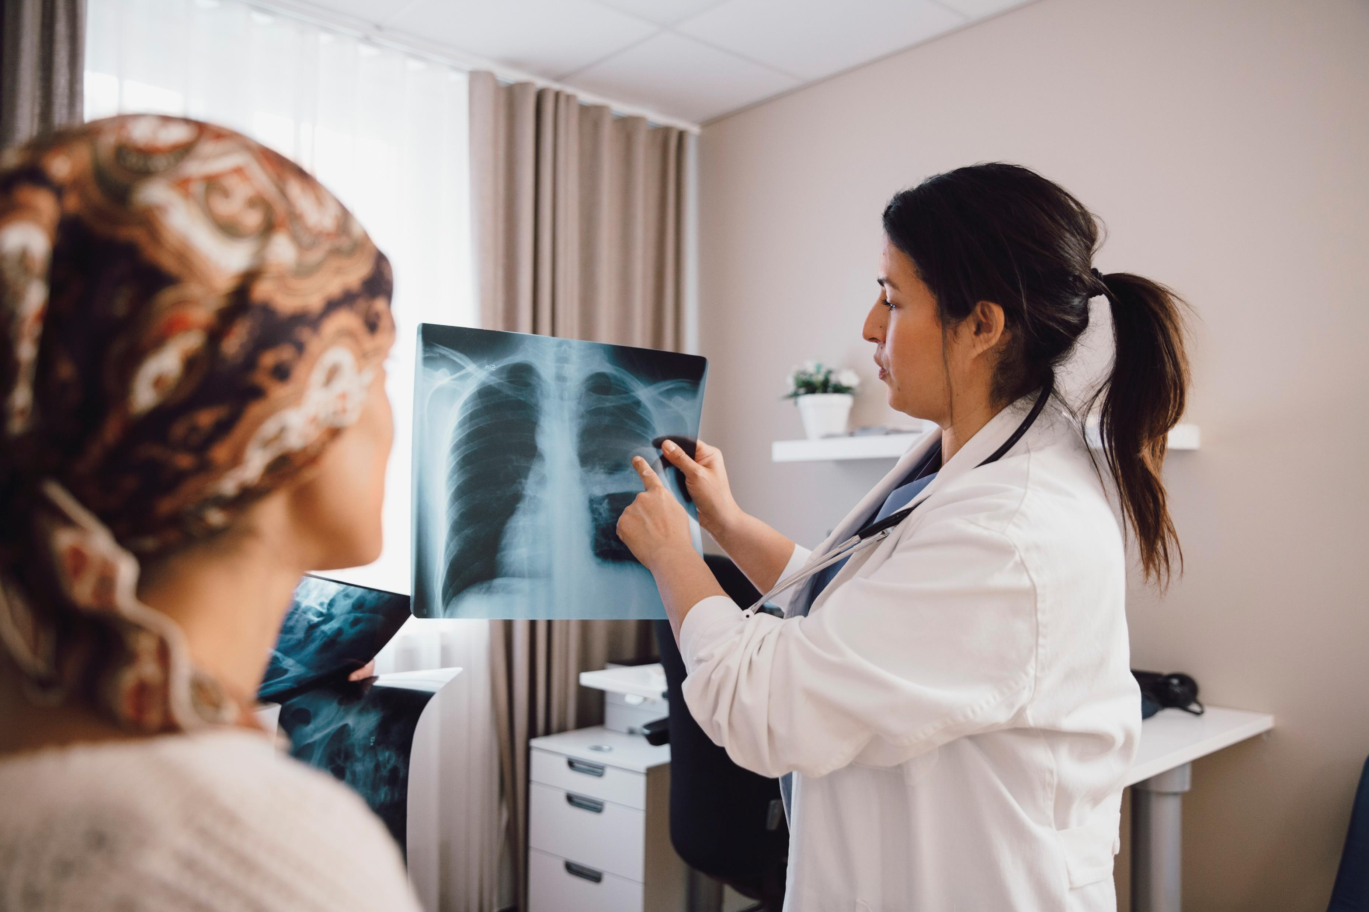
Technologies, Techniques, Algorithms
Algorithms and Techniques
K-means clustering algorithm
Convolutional Neural Network
Autoencoders
Technologies
Python
Flutter
Kaggle Notebook
Firebase
TensorFlow
Jupyter Notebook
Thresholding
IT21127946 | Christy H.M | R24-019

Slide 22
Work Breakdown Structure
Initiation
Project charter submission
Create a project proposal
Planning
Requirement analysis
Feasibility study
Design
Create use-case diagram
Create ER diagram
Implementation
Closeout
Gathering the relevant datasets
Create sequence diagram
Identification of chest images.
Implement database
Implement mobile application
Implement web site
Publish research paper
Final presentation
Host the mobile application
Design wireframes for mobile application
Design Mobile interfaces
Segmentation of layers of the image captured.
Extraction of layers related to the bones.
Construction of the chest X-ray.
3D image generation with the aid of the chest x-ray fed as the input.
IT21127946 | Christy H.M | R24-019

Slide 23
References
[1]S. Dixit, V. G. Pai, Vivian Claud Rodrigues, K. Agnani, and S R Vaishna Priyan, “3D Reconstruction of 2D X-Ray Images,” Dec. 2019, doi: https://doi.org/10.1109/csitss47250.2019.9031045.
‌
[2]P. Henzler, V. Rasche, T. Ropinski, and T. Ritschel, “Single-image Tomography: 3D Volumes from 2D Cranial X-Rays,” Computer Graphics Forum, vol. 37, no. 2, pp. 377–388, May 2018, doi: https://doi.org/10.1111/cgf.13369.
‌[3]N. M. Winch and A. Edgar, “X-ray imaging using a consumer-grade digital camera,” Nuclear Instruments and Methods in Physics Research Section A: Accelerators, Spectrometers, Detectors and Associated Equipment, vol. 654, no. 1, pp. 308–313, Oct. 2011, doi: https://doi.org/10.1016/j.nima.2011.06.087.
‌[4]X. Wang, S. Habert, C. Schulte, P. Fallavollita, and Nassir Navab, “Inverse visualization concept for RGB-D augmented C-arms,” Computers in Biology and Medicine, vol. 77, pp. 135–147, Oct. 2016, doi: https://doi.org/10.1016/j.compbiomed.2016.08.008.
[5]S. G. Panughpath and A. Kalyanpur, “Radiology and the mobile device: Radiology in motion,” Indian Journal of Radiology and Imaging, vol. 22, no. 04, pp. 246–250, Oct. 2012, doi: https://doi.org/10.4103/0971-3026.111469.
‌
‌
IT21127946 | Christy H.M | R24-019

Slide 24
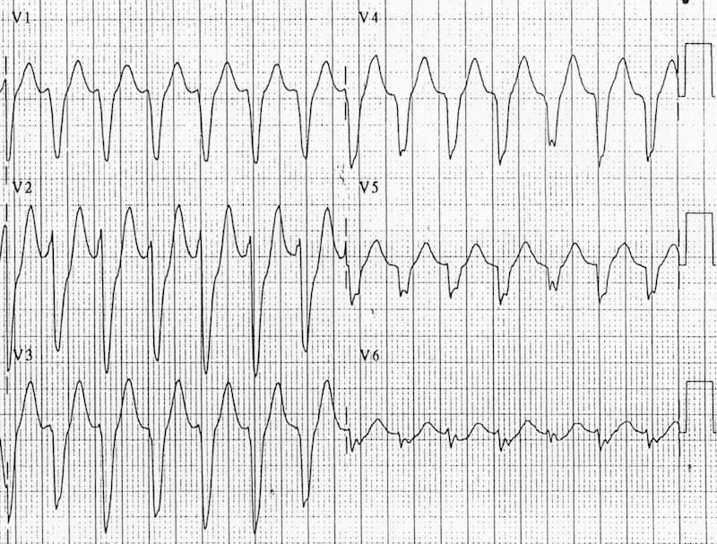

IT21126888 | Senadheera P.V.P.P
Specialization : Software Engineering
IT21126888 | Senadheera P.V.P.P | R24-019

Slide 25

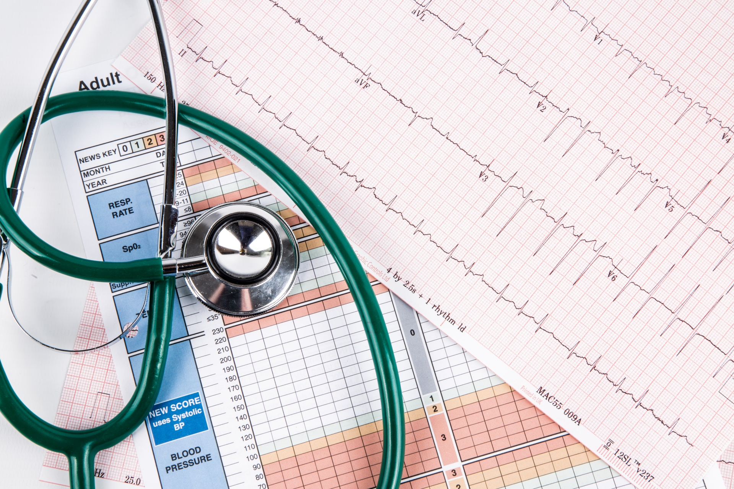
Background
Millions of people worldwide face cardiac abnormalities requiring continuous monitoring.
Electrocardiogram (ECG) is crucial for cardiac abnormality pre-identification.
Analyzes heart's electrical activity for accurate diagnosis.
Two primary mechanisms:
3-lead ECG - Requires 3 electrodes.
12-lead ECG - Requires 10 electrodes.
A 12-lead ECG is vital for precise cardiac analysis.
IT21126888 | Senadheera P.V.P.P | R24-019

Slide 26
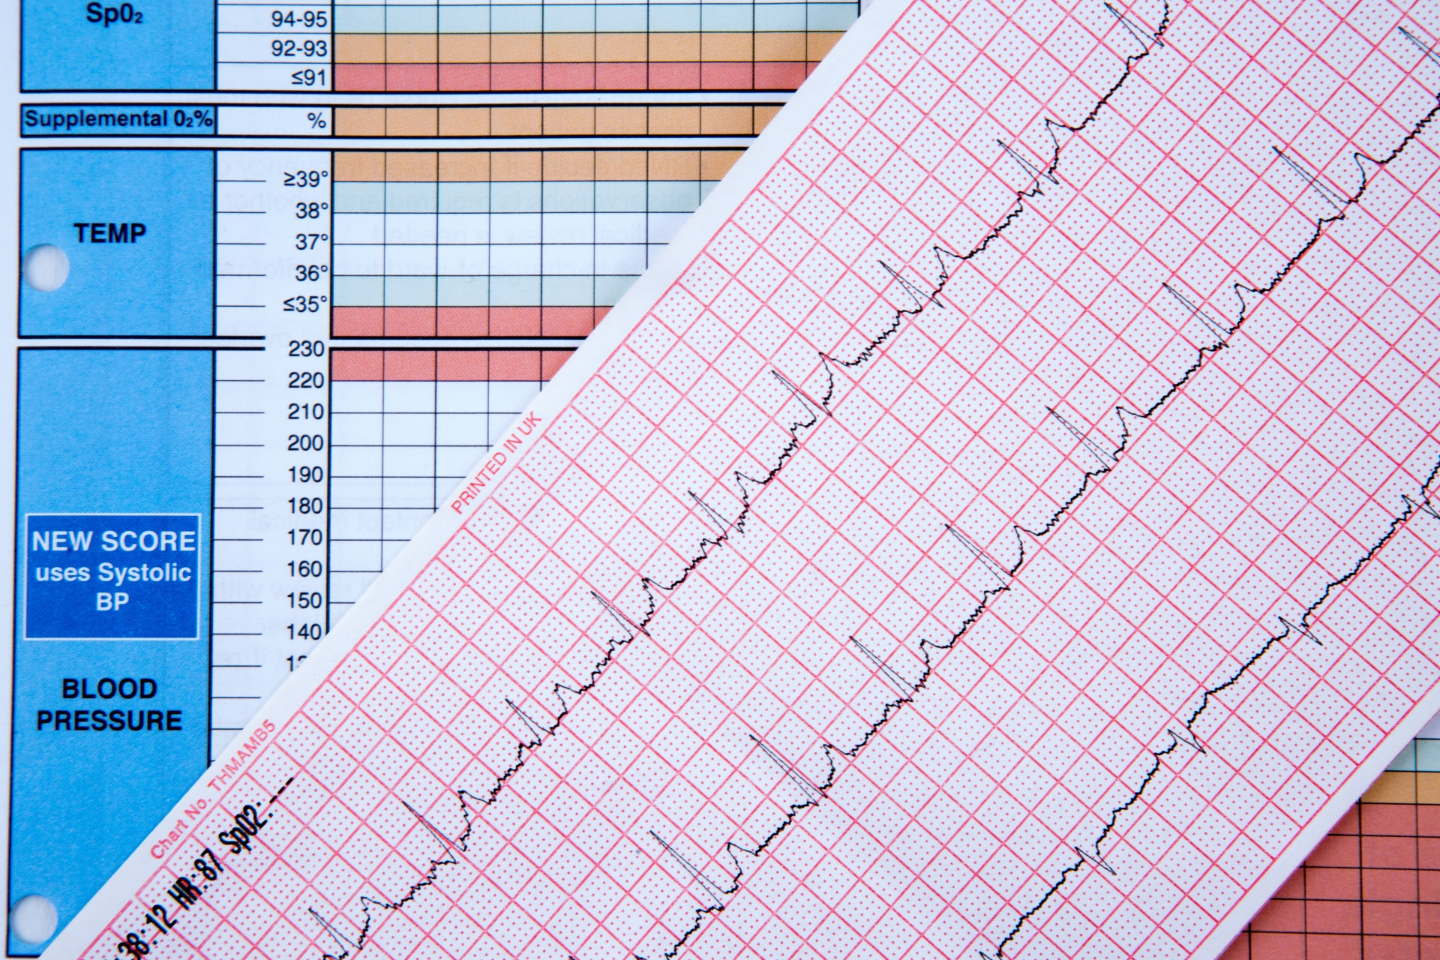
Research Question, Specific and Sub Objectives
Research Question:
How to extract 12-lead ECG information through hands(palms)?
Specific Objective:
Identification of cardiac rhythm through the analysis of palms.
Sub Objectives:
Determine the optimal ECG lead/s for obtaining accurate readings from the palms.
Reading the relevant ECG lead through dry electrodes.
Training the model to re-construct the remaining 11 ECG leads.
Design and implement a smart tablet-based platform for ECG viewing, facilitating user-friendly access and interpretation of cardiac data.
IT21126888 | Senadheera P.V.P.P | R24-019

Slide 27


Research Gap
 | A Palm Pilot based pocket ECG recorder [1] | ECG in Your Hands: A Multi-Vendor ECG Viewer for Personal Digital Assistants [2] | Flexible dry surface-electrodes for ECG long-term monitoring [3] | Palm-based ECG biometrics [4] | CardioResp AI
Dry electrodes
Using hands (palms)
12-lead ECG
IT21126888 | Senadheera P.V.P.P | R24-019

Slide 28
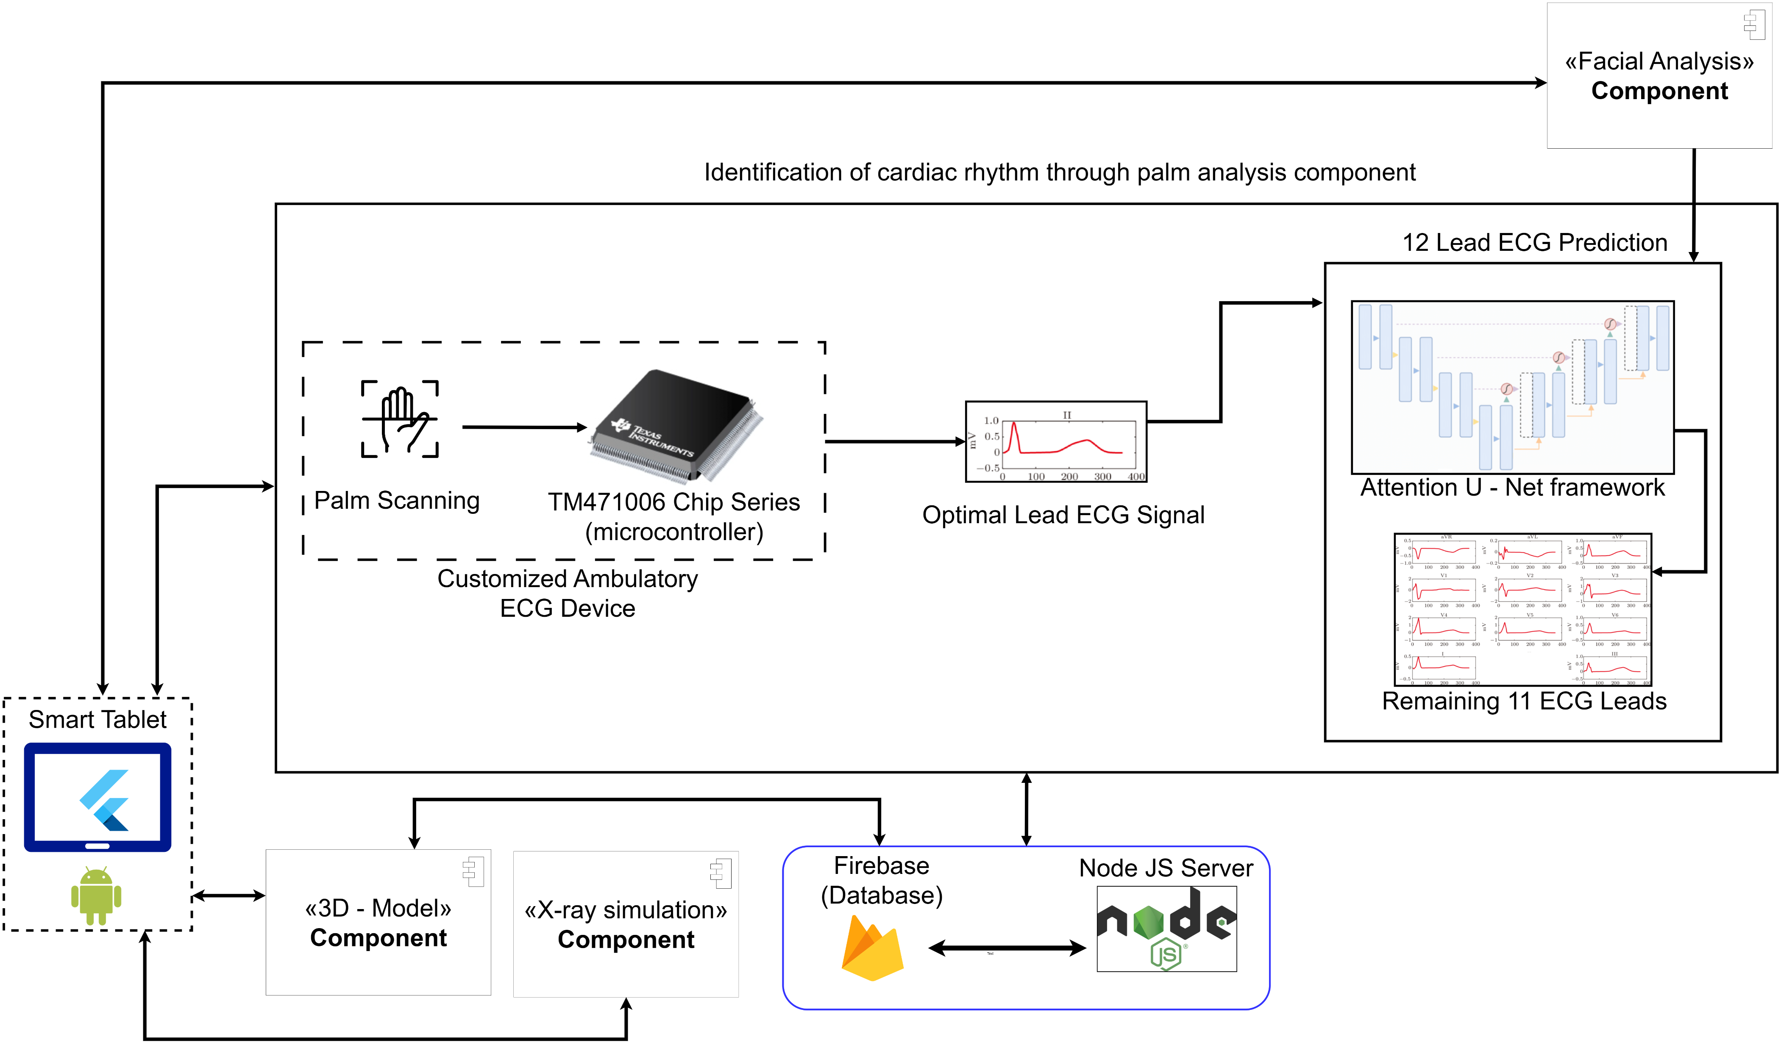
Methodology
IT21126888 | Senadheera P.V.P.P | R24-019

Slide 29
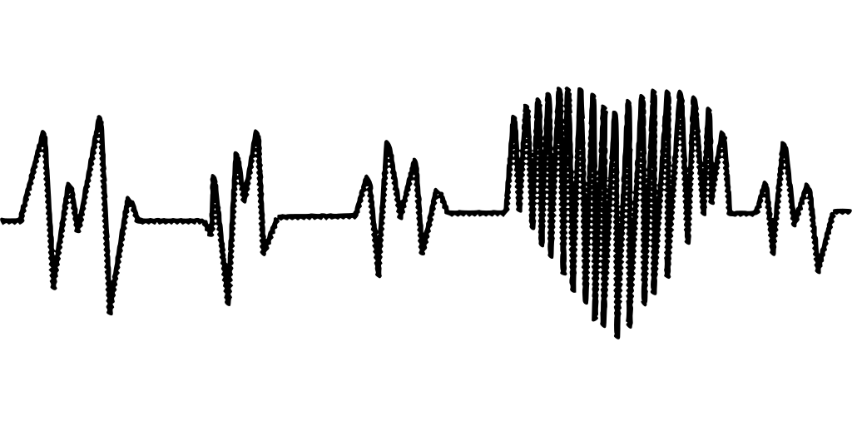
Technologies to be used
Technologies:
Flutter
Firebase
Python
TensorFlow
Keras
Jupyter Notebook
Kaggle Notebook
Node
Algorithms:
Convolutional Neural Networks (CNN)
Frameworks
Attention U-Net [5]
Techniques:
Feature selection
IT21126888 | Senadheera P.V.P.P | R24-019

Slide 30
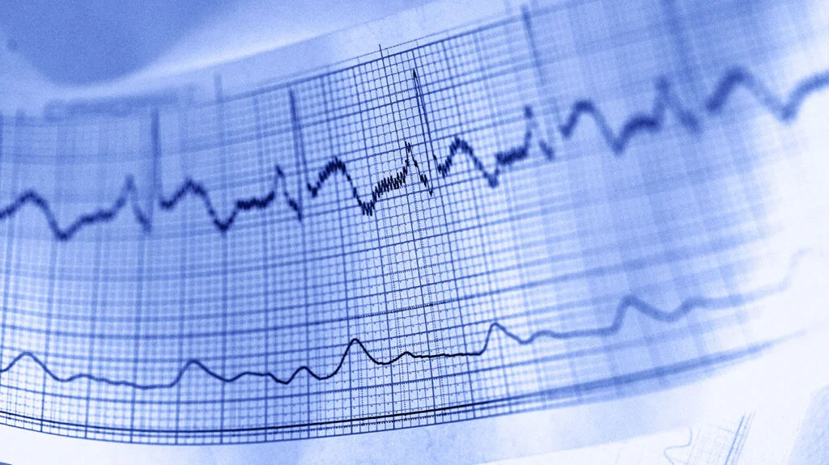
Methodology
Functional Requirements:
The optimal ECG lead obtained from the palms should be displayed in real-time.
The optimal ECG lead should be recorded for 10 seconds.
The remaining 11 leads should be acquired with high accuracy and displayed.
System Requirements:
PTB-XL large publicly available electrocardiography dataset
Non-Functional Requirements:
Interfaces should be User-friendly
The application should be reliable
Results should be more efficient
IT21126888 | Senadheera P.V.P.P | R24-019

Slide 31
Work Breakdown Structure
Initiation
Project charter submission
Create a project proposal
Planning
Requirement analysis
Feasibility study
Design
Create use-case diagram
Create ER diagram
Implementation
Closeout
Gathering the relevant datasets
Create sequence diagram
Build ECG signal acquisition module
Obtain the optimal ECG lead and process the signal
Build and train model to acquire the remaining 11 leads
Implement database
Implement mobile application
Implement web site
Publish research paper
Final presentation
Host the mobile application
Design wireframes for mobile application
Design Mobile interfaces
IT21126888 | Senadheera P.V.P.P | R24-019

Slide 32
References
[1] Yongning Zou and Zhenyu Guo, "A Palm Pilot based pocket ECG recorder," Proceedings 2000 IEEE EMBS International Conference on Information Technology Applications in Biomedicine. ITAB-ITIS 2000. Joint Meeting Third IEEE EMBS International Conference on Information Technol, Arlington, VA, USA, 2000, pp. 110-112, doi: 10.1109/ITAB.2000.892359.
[2] F. Chiarugi, M. Spanakis, P. J. Lees, C. E. Chronaki, M. Tsiknakis and S. C. Orphanoudakis, "ECG in your hands: a multi-vendor ECG viewer for personal digital assistants," Computers in Cardiology, 2003, Thessaloniki, Greece, 2003, pp. 359-362, doi: 10.1109/CIC.2003.1291166.
[3] Hoffmann, K. P., & Ruff, R. (2007). Flexible dry surface-electrodes for ECG long-term monitoring. Annual International Conference of the IEEE Engineering in Medicine and Biology Society. IEEE Engineering in Medicine and Biology Society. Annual International Conference, 2007, 5740–5743. https://doi.org/10.1109/IEMBS.2007.4353650
[4] André Lourenço, Ana Fred and Hugo Silva, “Palm-based ECG biometrics”, academia.edu, 2011.
[5] A. Garg, V. V. Venkataramani, and U. D. Priyakumar, “Single-Lead to Multi-Lead Electrocardiogram Reconstruction Using a Modified Attention U-Net Framework,” 2023 International Joint Conference on Neural Networks (IJCNN), Jun. 2023, Published, doi: 10.1109/ijcnn54540.2023.10191213.

Slide 33
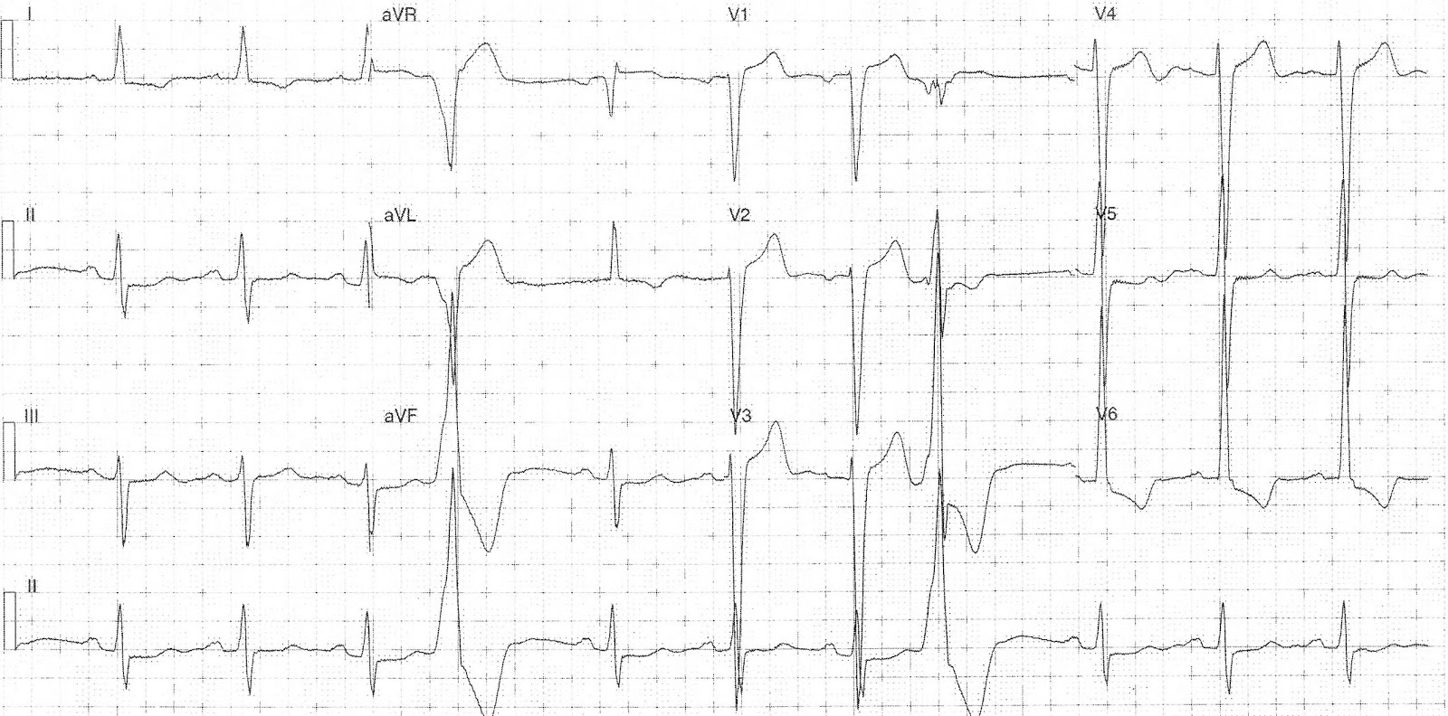

IT21138386 | Wijeratne D.M.S.D
Specialization : Software Engineering
IT21138386 | Wijeratne D.M.S.D | R24-019

Slide 34
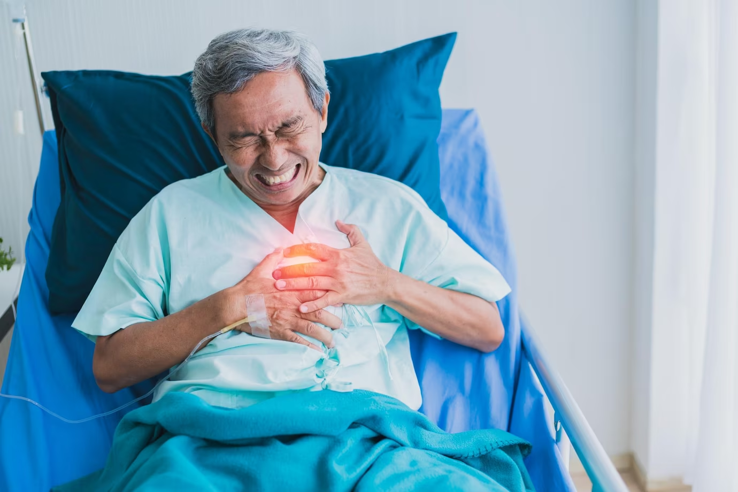
Background
Cardiac Diseases: A Global Health Crisis
According to World Health Organization (WHO) cardiac diseases are the number 1 cause of death in the entire world [1], claiming roughly 17.9 million lives each year.
The Importance of Early Detection
Early detection can have a huge impact on the health.
The 12-lead ECG is the gold standard for reliable heart health diagnosis [2].
Challenges with Current Solutions
ECG requires time, specialized equipment, and trained personnel [3].
Existing smart devices offer ECG readings, but they are not accurate [4], provide fewer leads, and are costly.
IT21138386 | Wijeratne D.M.S.D | R24-019

Slide 35
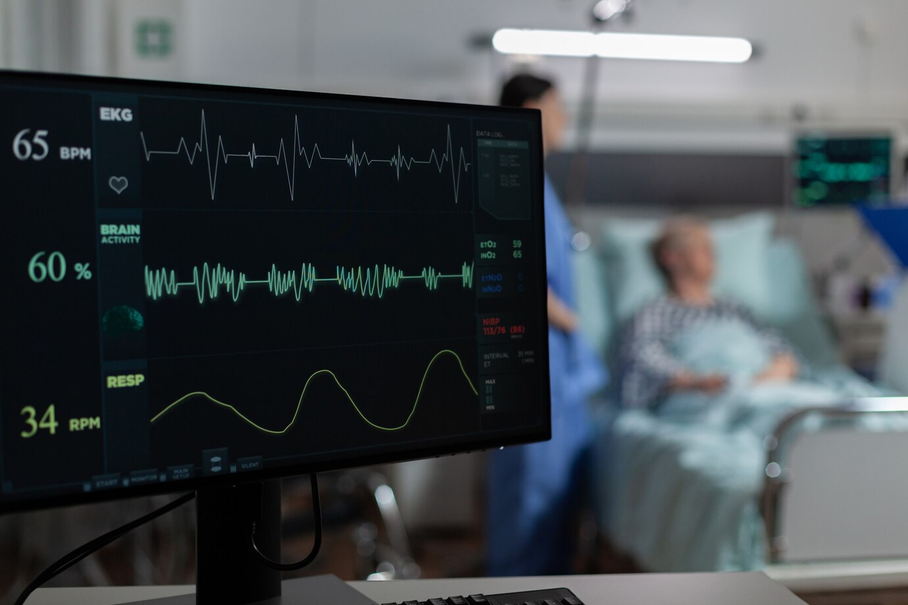

Research Question
How can ECG signals be extracted from facial recordings?
Measuring ECG signal requires physical contact with electrodes to assess the electrical activity of the heart.
How to obtain all 12 leads of ECG signal from facial recordings?
Traditional 12 Lead ECG machine uses 10 electrodes attached to various regions of the body to obtain 12 different views of the heart’s electrical activity.
IT21138386 | Wijeratne D.M.S.D | R24-019

Slide 36
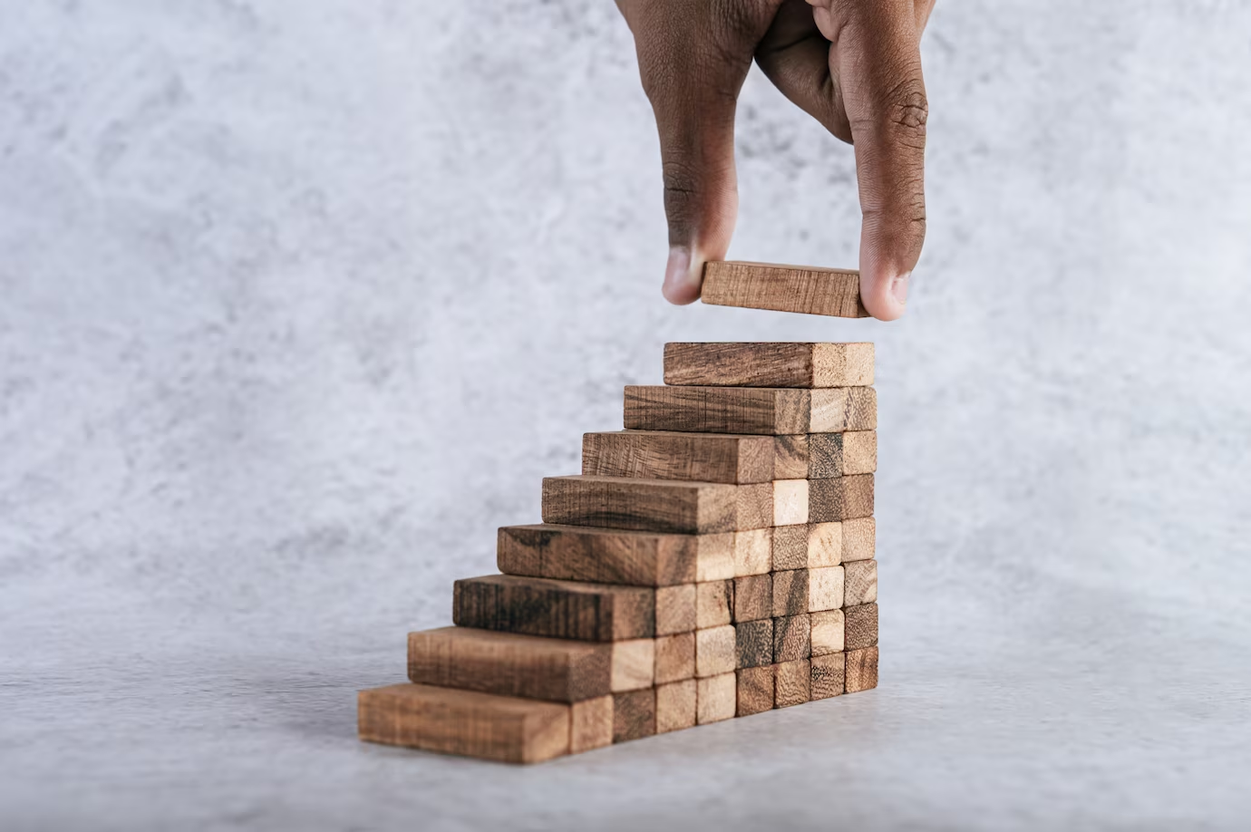

Specific Objective
Sub Objectives
Identification of facial region.
Extraction of physiologically related features from the face.
Generation of ECG signals.
Creation of a tablet device-based system to visualize ECG data.
Identification of cardiac rhythm through facial analysis
IT21138386 | Wijeratne D.M.S.D | R24-019

Slide 37

Research Gap
 | Research A | CardioResp AI
12 Lead ECG
Contactless approach
Portable device solution
Research A [5]
A study done on reconstructing ECG signals from facial videos using a Mult hierarchical feature representation structure.
They review two main categories of noncontact physiological measurement methods: unsupervised and supervised methods.
IT21138386 | Wijeratne D.M.S.D | R24-019

Slide 38
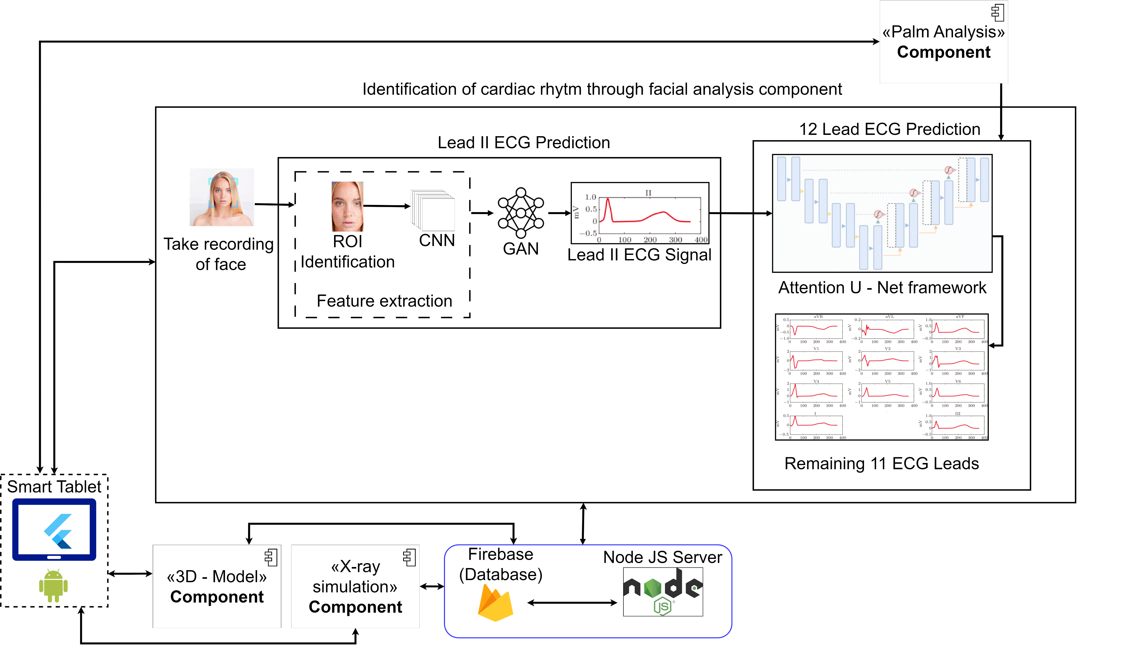
Methodology
IT21138386 | Wijeratne D.M.S.D | R24-019

Slide 39

Methodology
Functional Requirements:
Must ensure high accuracy of the generated Lead II ECG.
Should generate Lead II ECG reading of 10-second duration.
Must maintain high accuracy and 10-second duration for the predicted 11 remaining ECG leads.
Predicted results should be generated quickly.
System Requirements:
FaceBio dataset.
PTB-XL large publicly available electrocardiography dataset.
Non-Functional Requirements:
Interfaces should be intuitive and responsive for users.
The application should maintain a high level of reliability.
The application must ensure the confidentiality and integrity of the ECG and other data.
Regular backups of data should be carried out to prevent data loss.
User requirements
Users should be able to remotely assess their cardiac health at any time.
Users should have confidence in the reliability of the system to provide accurate and consistent results.
IT21138386 | Wijeratne D.M.S.D | R24-019

Slide 40


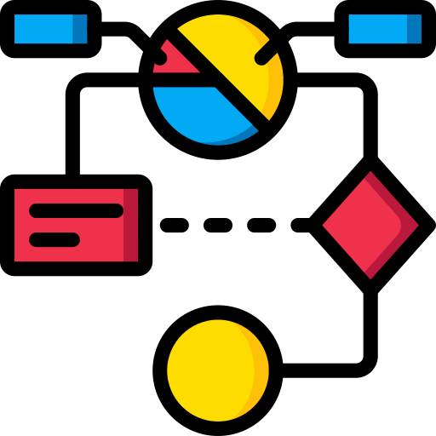


Technologies to be used
Technologies
Algorithms
Flutter
Firebase
Jupiter Notebook
Python
TensorFlow
Keras
OpenCV
Google Colab
Kaggle Notebook
Visual Studio Code
Node JS
CNN
Generative Adversarial Network (GAN)
Techniques
Feature selection
Frameworks
Attention U-net [6]
IT21138386 | Wijeratne D.M.S.D | R24-019

Slide 41
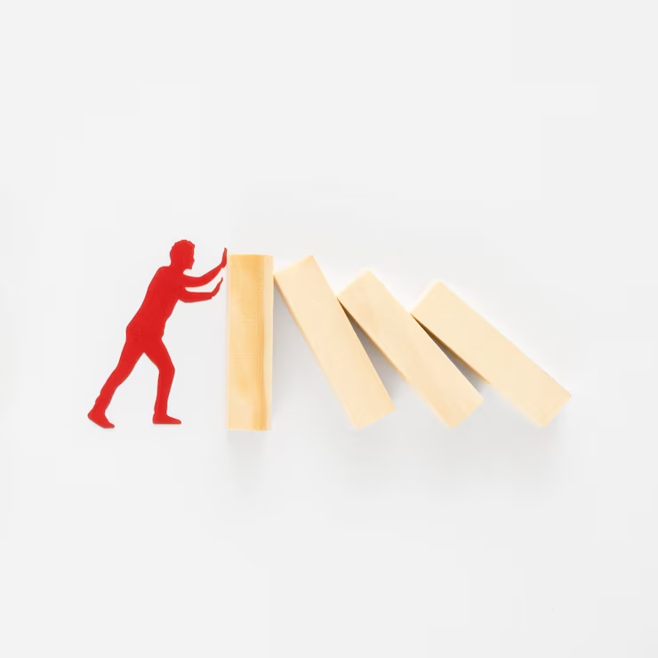
Work Breakdown Structure
Initiation
Project charter submission
Create a project proposal
Planning
Requirement analysis
Feasibility study
Design
Create use-case diagram
Create ER diagram
Implementation
Closeout
Gathering the relevant datasets
Create sequence diagram
Build and train model to generate Lead II ECG
Implement database
Implement mobile application
Implement web site
Publish research paper
Final presentation
Host the mobile application
Design wireframes for mobile application
Design Mobile interfaces
Build and train model to generate remaining 11 ECG Leads
Build module to identify Region Of Interest (ROI)
Extract physiological features
IT21138386 | Wijeratne D.M.S.D | R24-019

Slide 42
References
[1] “Cardiovascular diseases,” Jun. 11, 2019. https://www.who.int/health-topics/cardiovascular-diseases#tab=tab_1
[2] A. Bayés de Luna, M. Fiol‐Sala, and E. M. Antman, Eds., “The 12‐Lead ECG in ST Elevation Myocardial Infarction,” Jan. 2007, Published, doi: 10.1002/9780470750964.
[3] “12-Lead ECG Vs 6-Lead ECG Vs Single Lead ECG – Tricog Health,” Apr. 11, 2023. https://tricog.com/12-lead-ecg-vs-single-lead-ecg/
[4] “A Cardiologist’s Take on Smartwatch ECG Monitors and Heart Health | Jefferson Health.” https://www.jeffersonhealth.org/your-health/living-well/a-cardiologists-
[5] Bin Li, Wei Zhang, Xiaobai Li, Hong Fu, Feng Xu, ECG signal reconstruction based on facial videos via combined explicit and implicit supervision, Knowledge-Based Systems, Volume 272, 2023, 110608, ISSN 0950-7051, https://doi.org/10.1016/j.knosys.2023.110608.
[6]A. Garg, V. V. Venkataramani, and U. D. Priyakumar, “Single-Lead to Multi-Lead Electrocardiogram Reconstruction Using a Modified Attention U-Net Framework,” 2023 International Joint Conference on Neural Networks (IJCNN), Jun. 2023, Published, doi: 10.1109/ijcnn54540.2023.10191213.
IT21138386 | Wijeratne D.M.S.D | R24-019

Slide 43
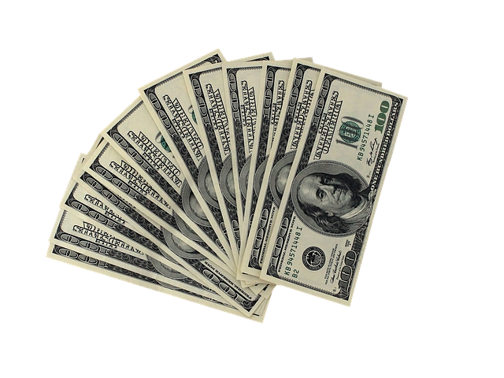
Completion of the project
Commercialization
Initially, it will be an application running on a system.
As more components are added, it will be developed into a telemedicine kit.
Allows people to assess their Cardiac and Pulmonary health remotely at their convenience.
Budget
Component | Price
Telemedicine kit | 500 USD
Subscription fee | 29 USD / month
Doctor Consultation Fee | 49 USD /month
Research & Development | 150,000 LKR per annum
Cloud hosting | 25,000 LKR per annum
Other costs | 30,000 LKR per annum

Slide 44

THANK YOU

